Slide 1
Class Imbalance Handling
October 26, 2024
Presented by: Tammy Liu, Yangyang Hou, Rebecca Yao and Norah Sun

Slide 2
Key Questions
What is class imbalance?
Why is it important?
When do you see class imbalance?
Describe methods to address imbalanced datasets in classification problems, provide examples and compare methods.

Slide 3
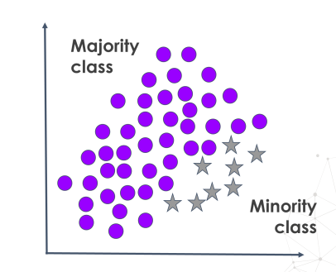
What is class imbalance?
Definition:
Class imbalance refers to a situation in classification problems where the number of instances belonging to one class significantly outnumbers those belonging to other classes.
Characteristics of Class Imbalance:
Skewed Class Distribution
Minority and Majority Classes
Occurs in Binary Classification Tasks
Notes:
What is Class Imbalance?
Class imbalance refers to a situation in classification problems where the number of instances belonging to one class significantly outnumbers those belonging to other classes. This imbalance means that some classes (typically the ones of most interest) are underrepresented compared to others.
In a dataset, if one class constitutes 90% of the data while the other class makes up only 10%, the dataset is considered imbalanced. The minority class is the one with fewer instances, and the majority class has more instances.
Characteristics of Class Imbalance:
Skewed Class Distribution: A disproportionate ratio of classes.
Minority and Majority Classes: One or more classes have significantly fewer instances (minority) compared to others (majority).
Occurs in Classification Tasks: Particularly in binary classification but can also be present in multi-class problems.

Slide 4
Why is Class Imbalance Handling Important?
Bias in Learning Algorithms
2. Misleading Evaluation Metrics
Algorithm Performance: Many standard classification algorithms assume an equal distribution of classes and aim to maximize overall accuracy.
Majority Class Dominance: Algorithms may become biased toward predicting the majority class, neglecting the minority class.
Learning Difficulty: The model may not learn the decision boundary for the minority class well due to insufficient examples.
Accuracy Paradox: High accuracy can be misleading in imbalanced datasets.
Need for Specialized Metrics: Metrics like precision, recall, F1-score, and area under the ROC curve (AUC-ROC) provide a better evaluation of model performance on imbalanced data.
Notes:
Class imbalance is important because it poses significant challenges to the development of effective machine learning models.

Slide 5
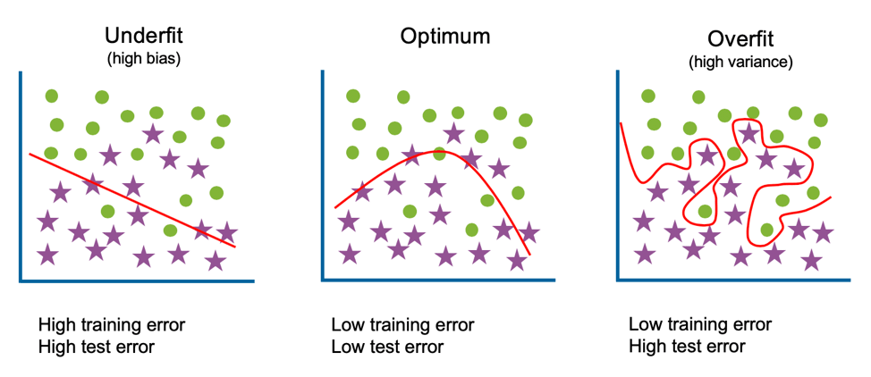
Why is Class Imbalance Handling Important?
3. Real-World Consequences
4. Data Representation
Critical Applications: In fields like medical diagnosis, fraud detection, and security, failing to detect minority class instances (e.g., disease cases, fraudulent transactions) can have severe implications.
Cost of Misclassification: The cost of incorrectly classifying a minority class instance is often much higher than that of a majority class instance.
Sample Representation: Minority classes may not provide enough examples for the model to learn patterns effectively.
Overfitting Risks: Models might overfit to the limited examples of the minority class or underfit by ignoring it altogether.

Slide 6
When do you see class imbalance?
Fraud Detection
2. Credit Default Prediction
Example: Fraudulent transactions are rare in comparison to legitimate transactions across banking, credit card usage, and online payments.
Reason for Imbalance: Financial institutions have security measures in place that reduce the frequency of successful fraud attempts, resulting in a majority of transactions being non-fraudulent.
Significance: Accurately detecting the minority class (fraud) is essential for minimizing financial losses and safeguarding customers' assets.
Example: Defaults on loans, credit cards, and other credit products are less frequent than successful repayments.
Reason for Imbalance: Most borrowers repay their loans, especially when financial institutions have screening processes to assess creditworthiness, leading to relatively few default cases.
Significance: Predicting credit default accurately helps banks manage risk, set interest rates, and maintain healthy loan portfolios.
Notes:
There are four common cases of class imbalance in finance.
The first is fraud detection, where we aim to identify fraudulent transactions among a large number of legitimate ones. Here, the minority (imbalanced) class is fraudulent transactions, while the majority class is legitimate transactions.
The second case is credit default prediction. In this context, we assess the probability of default among loan borrowers. The minority class is defaulted loans, and the majority class represents successful loan repayments. By estimating default likelihood, banks can make informed lending decisions, set appropriate interest rates, and deny high-risk loans. This not only protects institutions from financial losses but also promotes stability in the financial system through responsible lending practices.

Slide 7
When do you see class imbalance?
3. Rare Event Trading (e.g., Market Crashes)
4. Customer Churn in Financial Services
Example: Significant market crashes or extreme price drops are rare compared to day-to-day price fluctuations.
Reason for Imbalance: Major market events, such as crashes or sudden spikes in volatility, occur infrequently but have a large impact when they do happen.
Significance: Detecting these rare events is essential for managing portfolio risk, creating hedging strategies, and implementing risk management frameworks.
Example: In financial products and services, the majority of customers typically remain loyal, while only a small fraction decide to switch providers or cancel services.
Reason for Imbalance: Financial institutions often have retention strategies that keep churn rates low compared to the number of customers who stay.
Significance: Predicting customer churn allows financial institutions to proactively engage at-risk customers, reduce churn, and improve lifetime customer value.
Notes:
The third case of class imbalance is rare event trading. For example, market crashes. In this rare event trading scenario, these extreme market events form the ‘minority class,’ while normal fluctuations make up the ‘majority class.’ By predicting these rare events through analysis of historical and real-time data, we aim to detect potential instability or crashes early, giving us a crucial advantage in managing risk and preparing timely responses.
The fourth case of class imbalance in financial data is customer churn. For example, RBC customers may switch to TD if TD offers a higher interest rate. Predicting which customers might leave helps financial institutions identify those at risk of switching and take proactive steps, like offering incentives or improved services, to retain them. This approach is cost-effective, as keeping current customers is often less expensive than acquiring new ones, and it also helps banks better understand and meet customer needs.

Slide 8

Methods to solve problem
Undersampling
Cluster Centroid
Oversampling
SMOTE (Synthetic Minority Over-sampling Technique)
ADASYN (Adaptive Synthetic Sampling)
Bootstrap & Bagging
Notes:
I'll discuss two primary methods for addressing imbalanced datasets: Undersampling and Oversampling.
Starting with Undersampling, the aim is to reduce the number of samples in the majority class. A popular technique here is Cluster Centroid, where we cluster the majority class data and then sample from the centroids of these clusters.
Next, we have Oversampling, which increases the size of the minority class. SMOTE, or Synthetic Minority Over-sampling Technique, generates synthetic samples by interpolating between existing minority samples. ADASYN is similar, but just as its name, it focuses on areas where the minority class is harder to classify, therefore improving model focus on difficult regions. Another approach is Bootstrap & Bagging, where multiple balanced subsets are created, often for ensemble learning.

Slide 9
Comparison of Two Methods
Undersampling
Oversampling
Pros:
Less Overfitting Risk
Reduce Training Time
Cons:
Loss of Information
Not Ideal for Small Datasets
Risk of Increased Variability
Pros:
Preservation of Minority Class Information
Improved Model Performance
Better for Small Datasets
Cons:
Risk of Overfitting
Increased Training Time
Synthetic Sample Quality
Notes:
Let’s compare the pros and cons of Undersampling and Oversampling.
Recall that instead of duplicating the minority class, the undersampling technique reduce the number of observations of the majority class. It ultimately reduces the sample data size. The main advantages of undersampling are a reduction in training time and a lower risk of overfitting. However, it has some drawbacks, such as loss of information from the majority class, making it less suitable for small datasets, and it may introduce variability based on which samples are removed.
For Oversampling:
It preserves minority class information, often improves model performance on the minority class, and can be beneficial for small datasets. On the downside, oversampling can lead to overfitting, increases training time, and may produce synthetic samples that don’t fully capture real-world complexities.

Slide 10
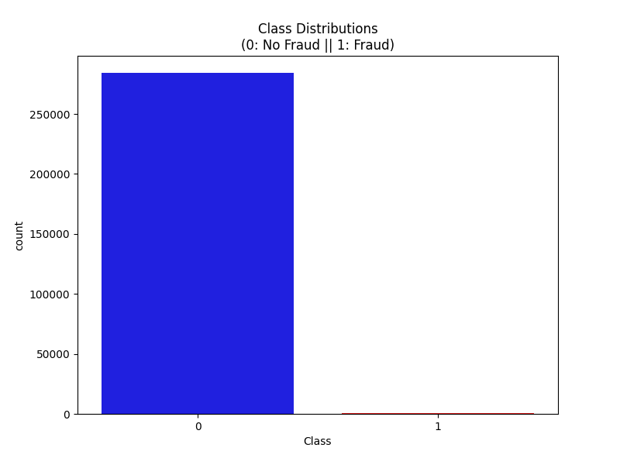
EXAMPLE – Credit Fraud Detector
There are no "Null" values, so we don't have to work on ways to replace values.
Most of the transactions were Non-Fraud (99.83%) of the time, while Fraud transactions occurred (0.17%) of the time.
GitHub Link：https://github.com/tammyliuu/DataScience-2025

Slide 11
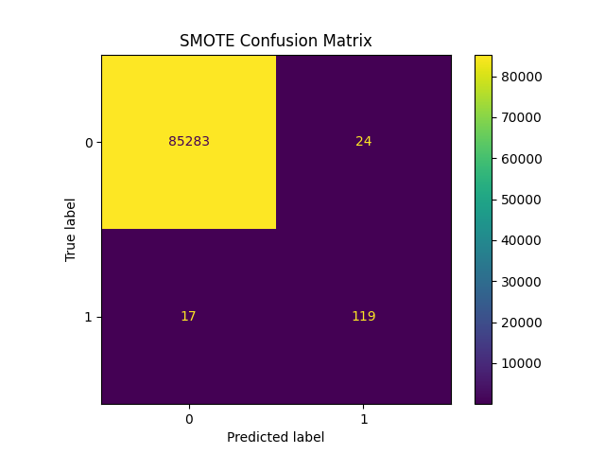
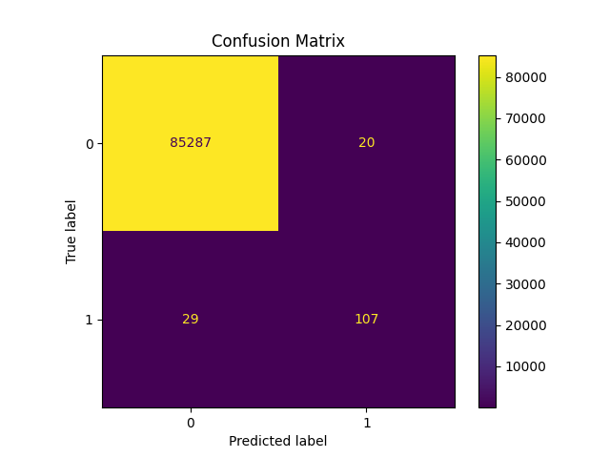
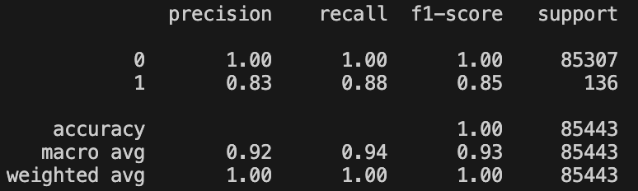
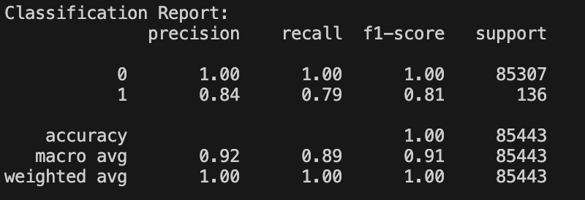
The Report of oversampling methods
SMOTE & ADASYN
Bagging & Bootstrap
Class distribution after SMOTE: {np.int64(0): np.int64(199008), np.int64(1): np.int64(199008)}
Notes:
SMOTE & ADASYN has fewer false negatives (17) compared to Bagging & Bootstrap (29), indicating a slightly better ability to detect the minority class.
Both methods show a strong ability to identify the majority class, with minimal false positives.
SMOTE & ADASYN: Demonstrates better recall and F1-score for the minority class (class 1), making it more effective for detecting minority events.
Reason why SMOTE has high F1
creates synthetic samples for the minority class, helping to balance the dataset;
Bagging: it focuses on improving model stability by averaging predictions from multiple models trained on different samples. it does not specifically generate more samples of the minority class
SMOTE-generated samples help improve recall by making the minority class more visible during training.

Slide 12
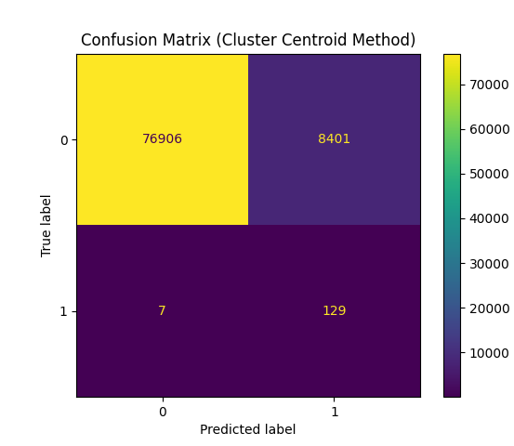
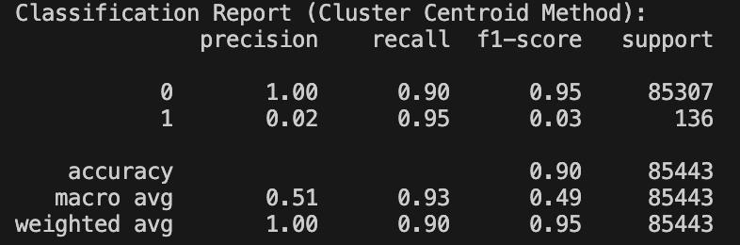
The Report of under-sampling method
Notes:
The Cluster Centroid Method has a significantly higher number of false positives (8,401) compared to SMOTE (24). This cause Cluster method Achieves high recall for the minority class but at the cost of a low precision. So the F1 score for Class 1 (Fraud) is very low. (F1 = 2/(1/recall+1/precision))
This could indicate that the undersampling method reduces the model's ability to correctly identify the majority class, likely due to the loss of valuable information in the majority class.

Slide 13
Thank You!

